Slide 1
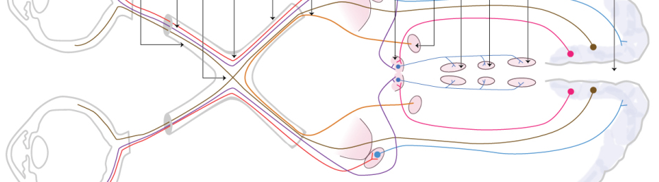
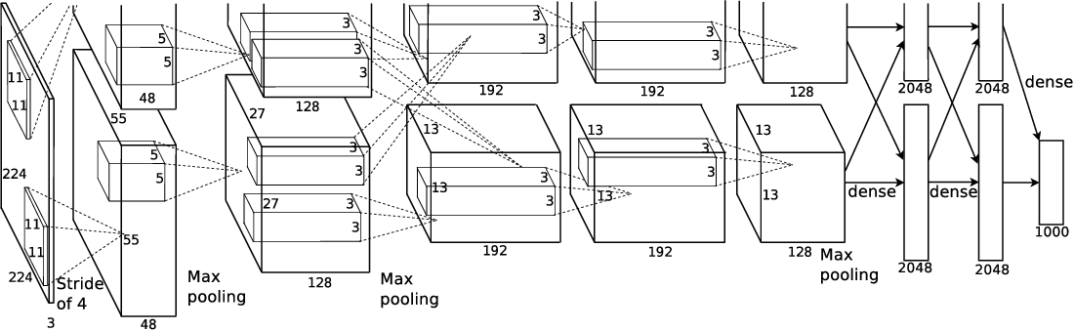
Convolutional NN

Slide 2
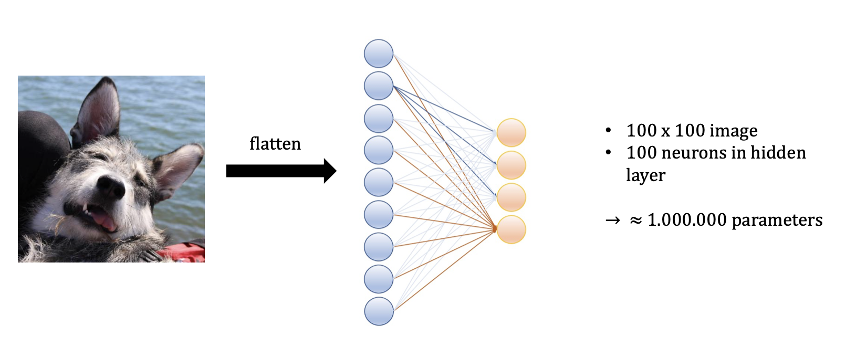
Fully (densely) connected layer

Slide 3
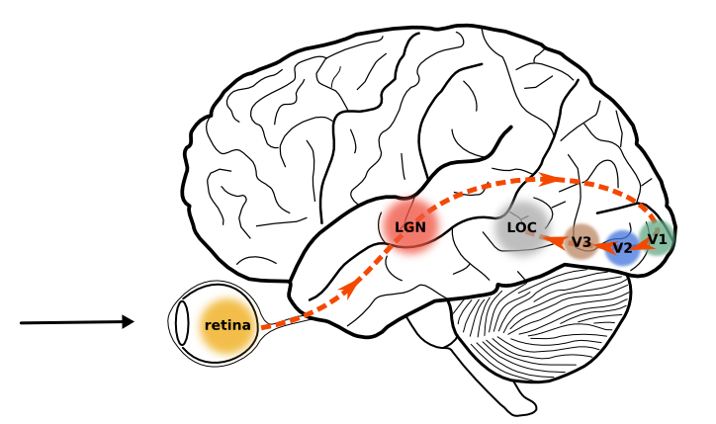
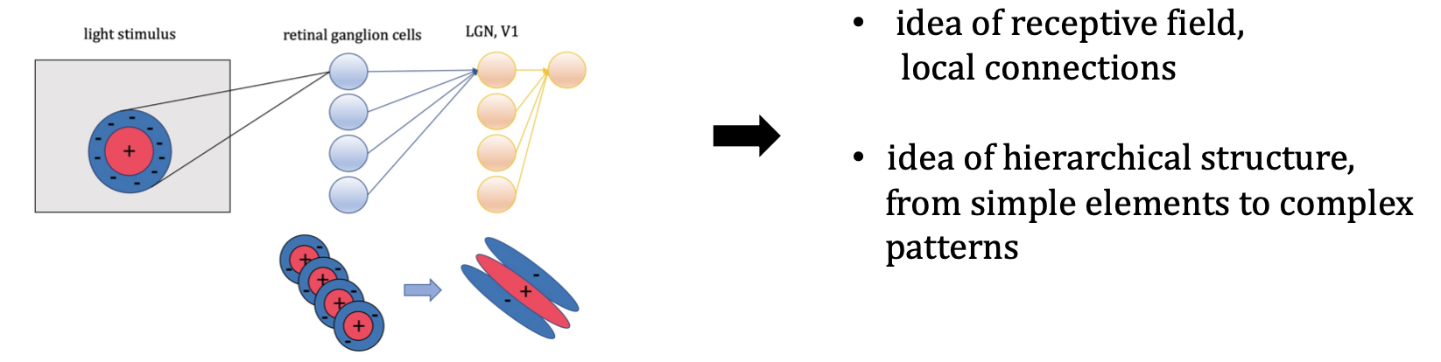

Slide 4
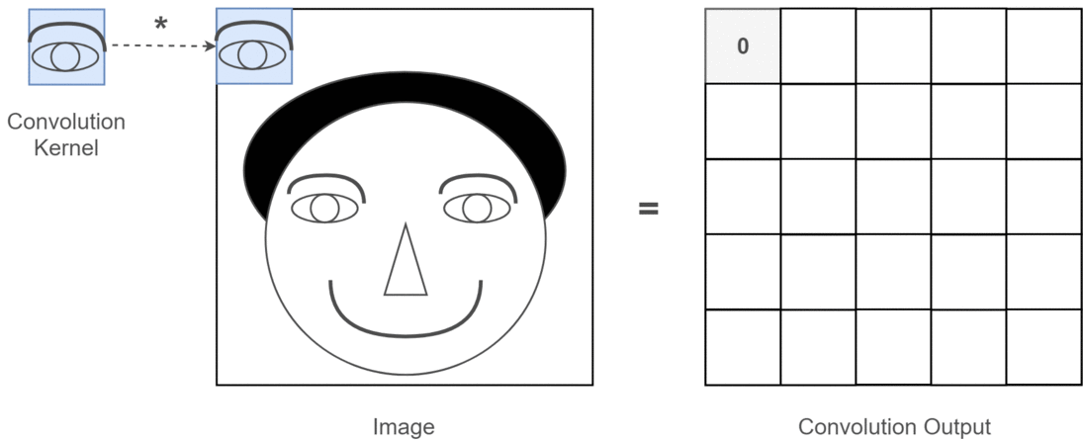
CNN - Biologically inspired ANN architecture

Slide 5

Convolution

Slide 6
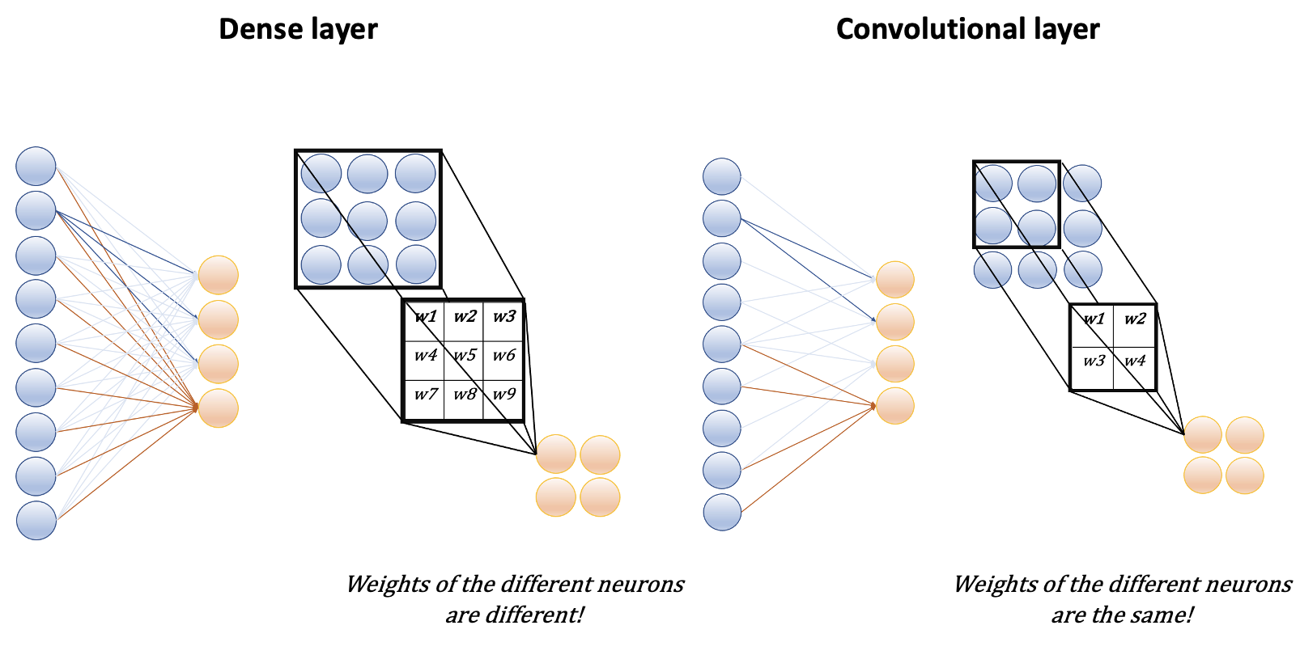

Slide 7
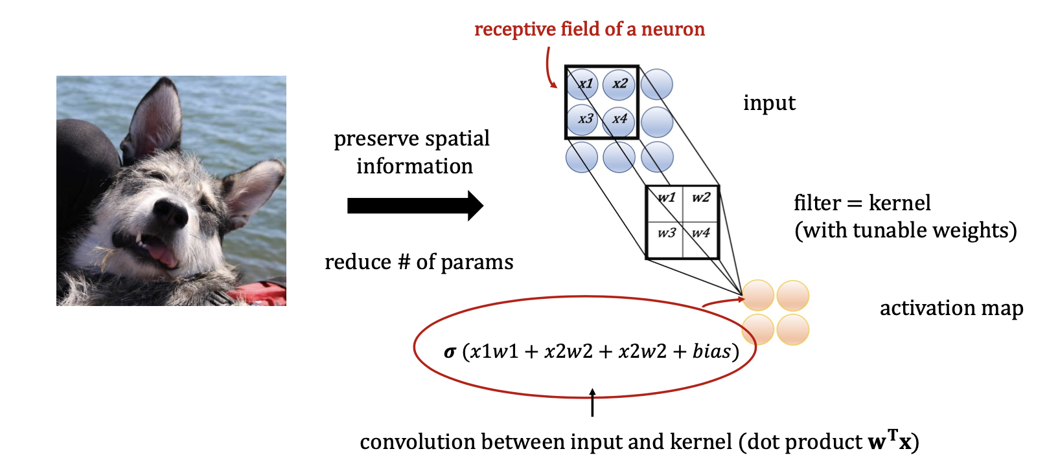
Convolutional layer

Slide 8
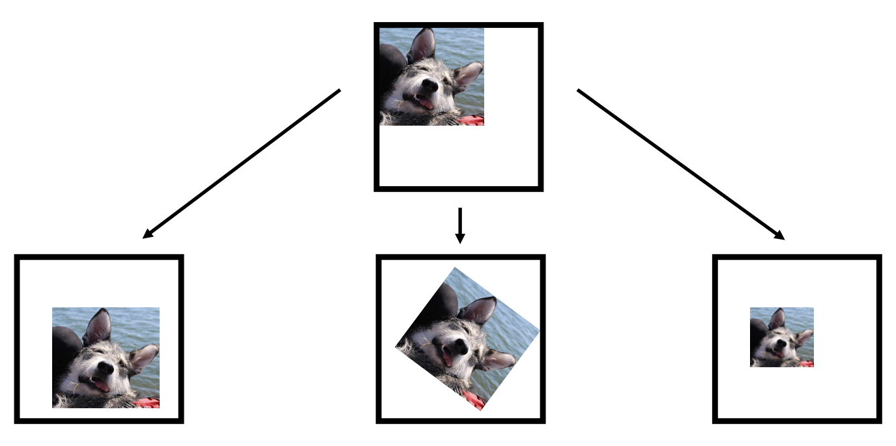

Slide 9
Hans-on: image classification with CNN
# Convolutional layer
tf.keras.layers.Conv2D(units=16,
kernel_size=3,
padding="same",
activation="relu")

Slide 10
Hans-on: image classification with CNN
model = tf.keras.models.Sequential([
# input + (Conv → Conv → Pool) block
tf.keras.layers.Conv2D(16, 3, padding="same", activation="relu", input_shape=[28,28,1]),
tf.keras.layers.Conv2D(16, 3, padding="same", activation="relu"),
tf.keras.layers.MaxPool2D(pool_size=2)
# Flatten
tf.keras.layers.Flatten(),
# 1st Dense layer
tf.keras.layers.Dense(64,"relu")
# 2nd Dense (output) layer
tf.keras.layers.Dense(10, activation="softmax")
])

Slide 11
Gradient Descent Algorithm
1. Forward pass
3. Backward pass
4. Update weights
2. Compute loss
ŷ

Slide 12
Gradient Ascent Algorithm
1. Forward pass
3. Backward pass
4. Update input
2. Compute loss,
e.g. mean activation

Slide 13
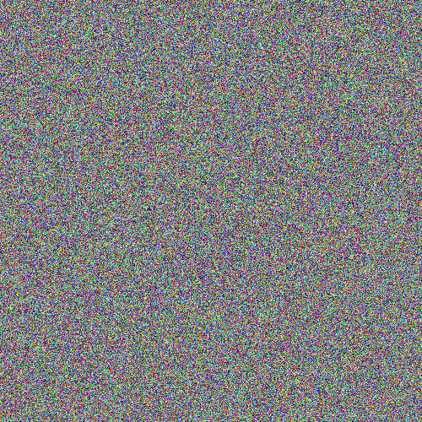
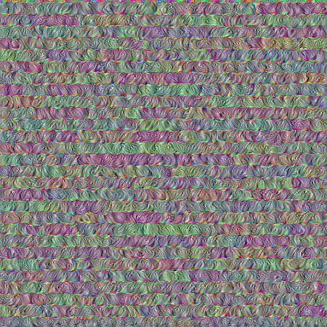

Slide 14
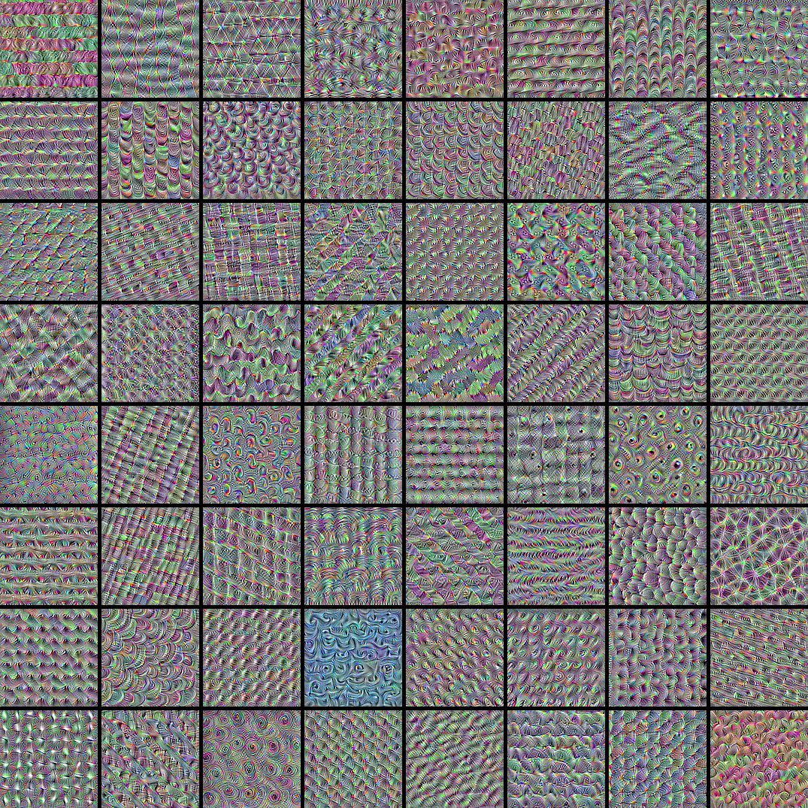

Slide 15
How convolutional neural networks see the world
”… what do they really "understand"?
Two things: first, they understand a decomposition of their visual input space as a hierarchical-modular network of convolution filters, and second, they understand a probabilistic mapping between certain combinations of these filters and a set of arbitrary labels.
Naturally, this does not qualify as "seeing" in any human sense, and from a scientific perspective it certainly doesn't mean that we somehow solved computer vision at this point.
Don't believe the hype; we are merely standing on the first step of a very tall ladder.”

Slide 16
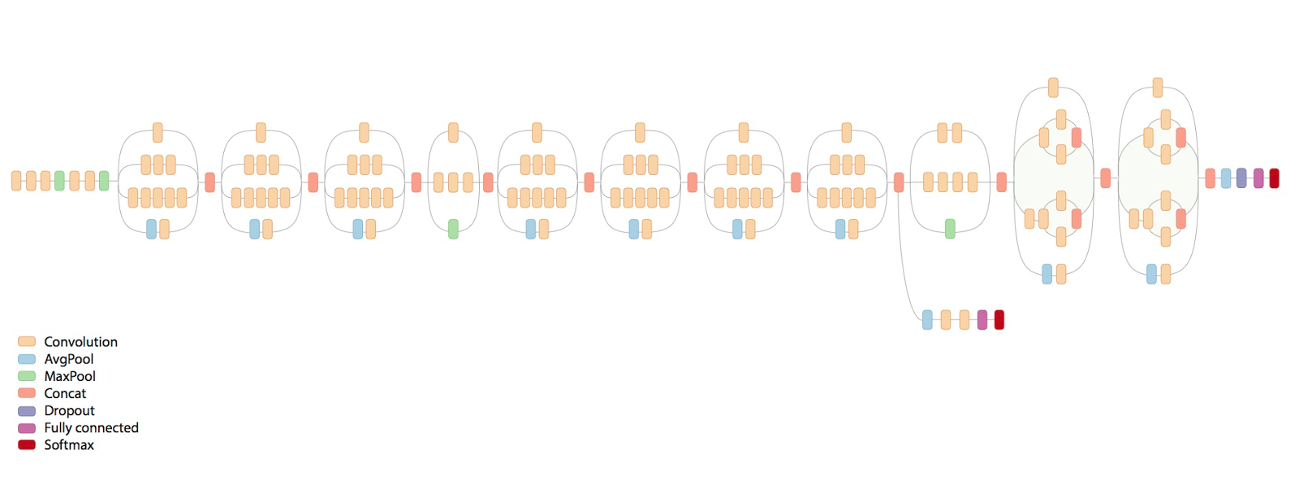
Hands-on: Deep Dream Inception v-3
mixed0
mixed1
….
mixed10

Slide 17
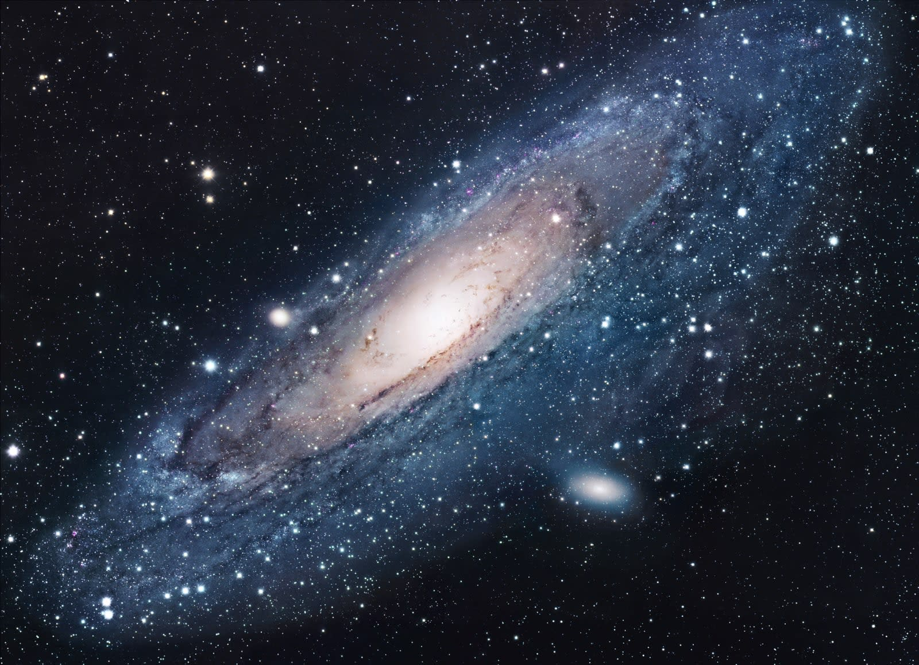
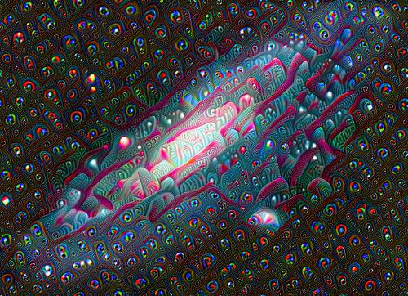
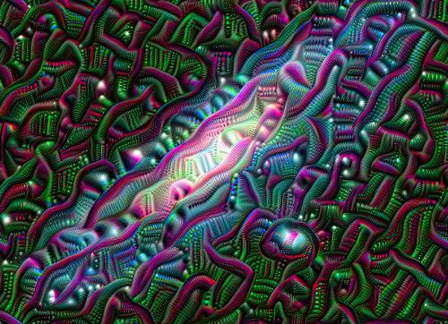
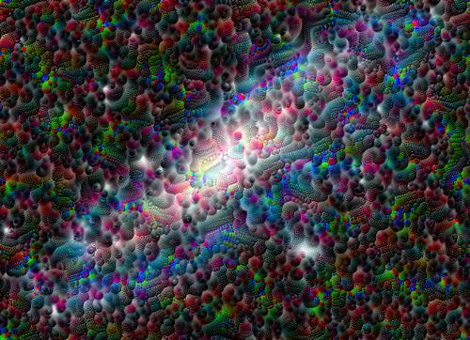
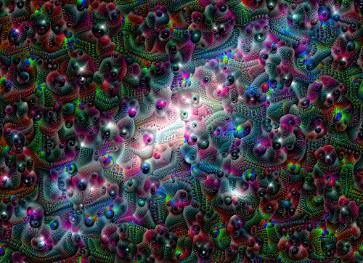
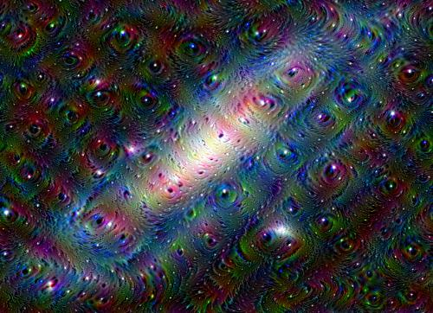
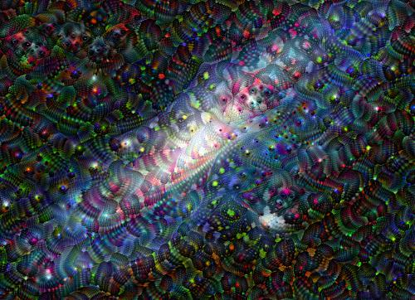
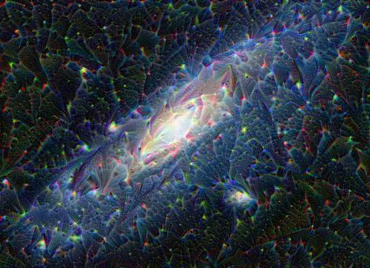
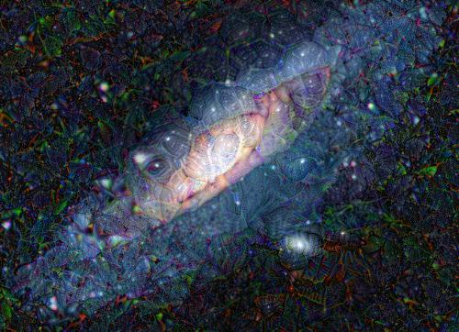
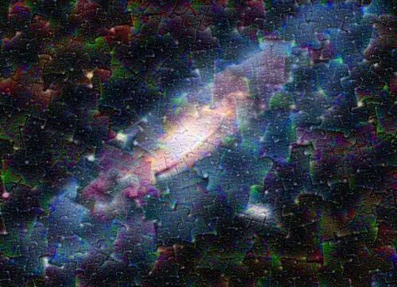
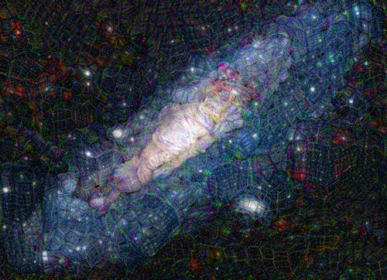
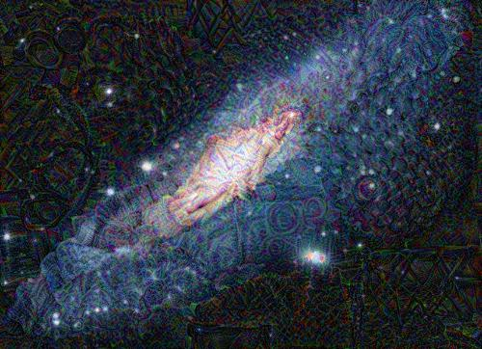

Slide 18
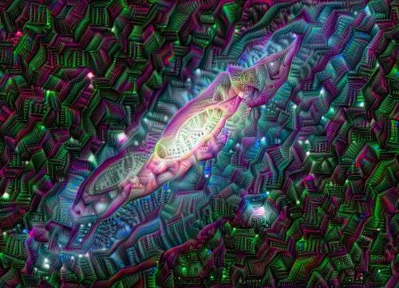
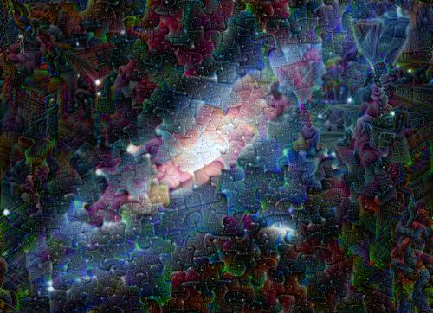
+
=
+
=

Slide 19
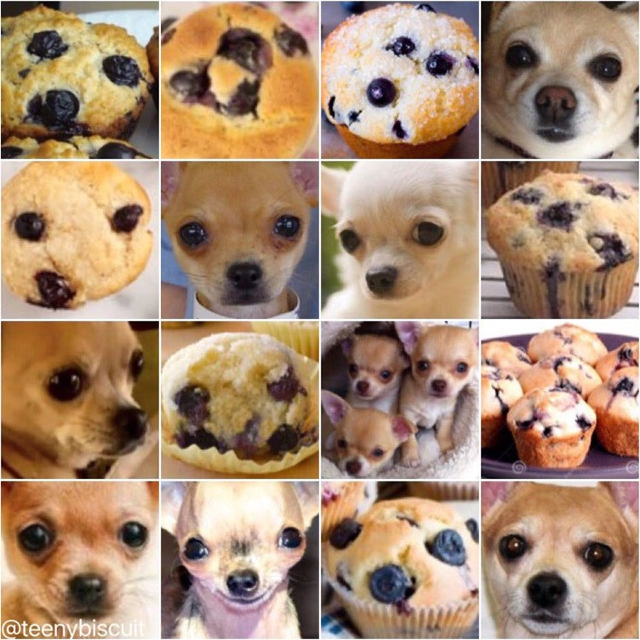

Slide 20
Advanced techniques with Deep Dream
Zooming in at each step → infinite animation
Painting ping-pong with Deep Dream:
- Use your painting as input
- Get Deep Dream output
- Zoom-in until good pattern appears
- Paint based on observed pattern
- Repeat n-times
- Compile video
"Neverending Story" music video

